Slide 1

Working with Files Chapter # 3 Lecture # 11, Week # 6
Dr. Muhammad Bilal Qureshi
m.qureshi@centralasian.uz
Central Asian University, Tashkent, Uzbekistan

Slide 2
Source
Textbook:
Beginning Linux Programming 4th Edition by Neil Matthew

Slide 3
Contents
Other system calls for managing files
lseek
fstat, stat and lstat
dup and dup2
The standard I/O library
Other Stream Functions
Stream Errors
Streams and File Descriptors

Slide 4
Positioning with lseek System Call
▶ The lseek system call sets the read/write pointer of a file descriptor, fildes;
▶ You can use it to set where in the file next read or write will occur.
▶ You can set the pointer to an absolute location in file or to a position relative to the current position or end of file.
▶ Defined in:
<unistd.h>
<sys/types.h>

Slide 5
Function Prototype
▶ fildes: File descriptor of an open file.
▶ offset: Position to move the pointer.
▶ whence: Reference position
whence can have the following values:
▶ SEEK_SET: Offset is absolute (from the beginning).
▶ SEEK_CUR: Offset is relative to the current position.
▶ SEEK_END: Offset is relative to the end of the file.

Slide 6
Return value
▶ On success, lseek() returns the new file position (offset in bytes).
▶ On failure, it returns -1 and sets errno.
▶ The type off_t is used for file offsets.
▶ It is an implementation-dependent integer type.
▶ Defined in <sys/types.h>

Slide 7
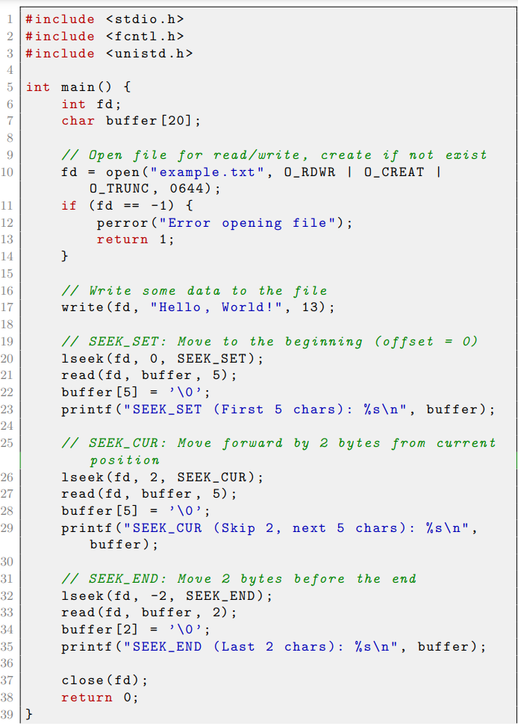
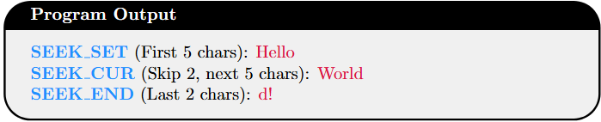
lseek system call example
Notes:
Why Do We Need to Add \0 Manually?
read() only fills the buffer with raw bytes from the file.
It does not assume the data is a string.
It does not null-terminate the buffer.
In C, strings must be null-terminated (\0) to properly work with functions like printf(), strlen(), etc.

Slide 8
fstat System call
The fstat system call returns status information about the file associated with an open file descriptor.
The information is written to a structure, buf, the address of which is passed as a parameter.
#include <unistd.h>
#include <sys/stat.h>
#include <sys/types.h>
int fstat(int fildes, struct stat *buf);
int stat(const char *path, struct stat *buf);
int lstat(const char *path, struct stat *buf);

Slide 9
stat and lstate System Calls
The related functions stat and lstat return status information for a named file. They produce the same results, except when the file is a symbolic link.
lstat returns information about the link itself, and stat returns information about the file to which the links refers to.
In short, the stat, fstat, and lstat system calls retrieve file information in Linux. These functions provide metadata such as file size, permissions, and modification time.

Slide 10
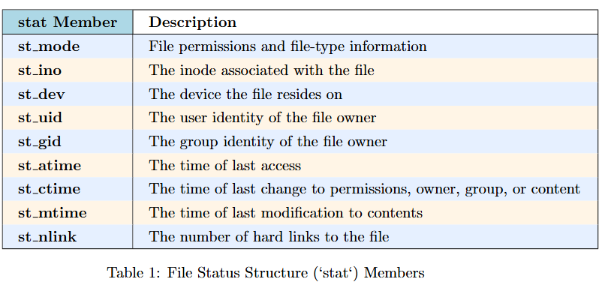
Members of struct stat

Slide 11
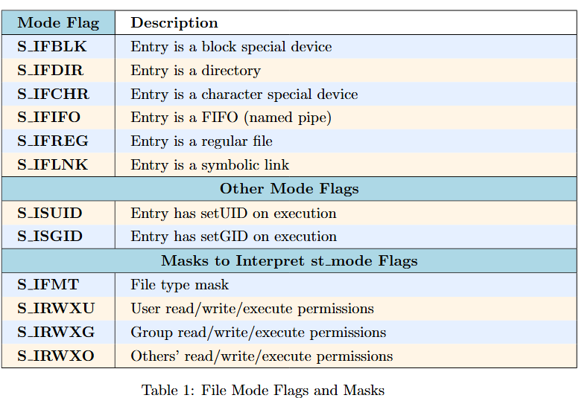
Cont()..
File type flags include
The st_mode flags returned in the stat structure also have number of associated macros defined in the header file sys/stat.h.
These macros include names of permission and file-types flags and some masks to help with testing for special types and permissions. The permission flags are the same as for the open system call.
Example 1
Example 2
Example 3
Notes:
#include <sys/types.h>
#include <sys/stat.h>
#include <stdio.h>
int main() {
struct stat fileStat;
if (stat("example.txt", &fileStat) == 0) {
if ((fileStat.st_mode & S_IRWUX) == S_IRWUX) {
printf("The file has full read, write, and execute permissions for everyone.\n");
} else {
printf("The file does not have full permissions.\n");
}
} else {
perror("stat");
}
return 0;
}
#include <sys/types.h>
#include <sys/stat.h>
#include <unistd.h>
#include <stdio.h>
int main() {
struct stat fileStat;
if (stat("example.txt", &fileStat) == 0) {
mode_t user_perms = fileStat.st_mode & S_IRWXU; // Mask only owner permissions
printf("Owner permissions: ");
if (user_perms & S_IRUSR) printf("read ");
if (user_perms & S_IWUSR) printf("write ");
if (user_perms & S_IXUSR) printf("execute ");
printf("\n");
} else {
perror("stat");
}
return 0;
}

Slide 12
dup and dup2 System Calls
The dup system calls provide a way of duplicating a file descriptor, giving two or more different descriptors that access the same file.
These might be used for reading and writing to different locations in the file.
The dup system call duplicates a file descriptor, fildes, returning a new descriptor.
The dup2 system call effectively copies one file descriptor to another by specifying the descriptor to use for the copy.

Slide 13
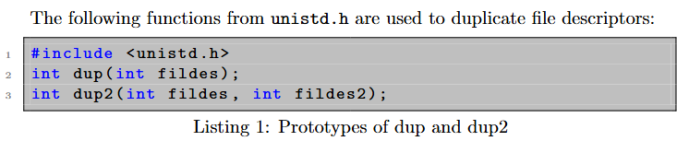
Function Prototype

Slide 14
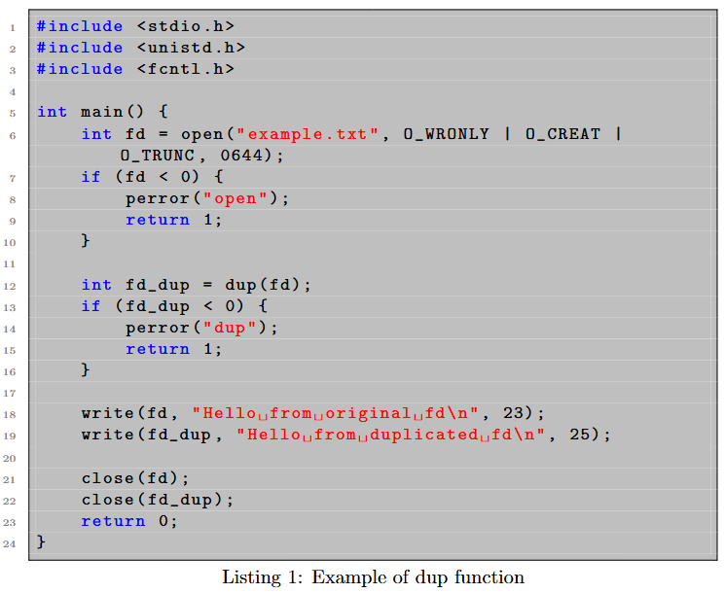
Example dup()

Slide 15
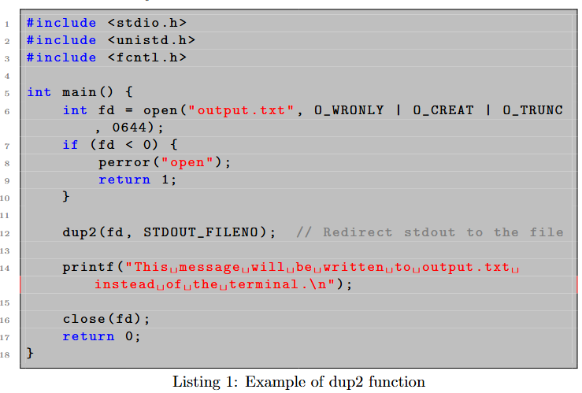
Example dup2()

Slide 16
The standard I/O Library
The standard I/O library (stdio) and its header file, stdio.h, provide a versatile interface to low-level I/O system calls.
The library, is a part of ANSI standard C, whereas the system calls are not, provides many functions for formatting output and scanning input. It also takes care of buffering requirements for devices.
Library is used in the same way you used low-level file descriptor. First Open the file ….
The equivalent of the low-level file descriptor is called a stream and is implemented as a pointer to structure, a FILE *.
Just like descriptors, three file streams are automatically open when program is started. stdin, stdout and stderr (all declared inside stdio.h)

Slide 17
Stdio library functions (go through yourself )
fopen, fclose
fread, fwrite
fflush
fseek
fgetc,getc,getchar
fputc,putc, putchar
fgets, gets
printf, fprintf and sprint
scanf, fscanf and sscanf
Notes:
Fflush #include <stdio.h> int main() { printf("Hello, World!"); fflush(stdout); // Ensure "Hello, World!" is printed immediately return 0; }
Fseek The fseek() function moves the file pointer to a specified position in a file.
Fgetc ->read file->
Getc-> read file-> may be faster
Getchar-> read from stdin
Fputc -> write file
Putc->write to file
Putchar-> write to stdout

Slide 18
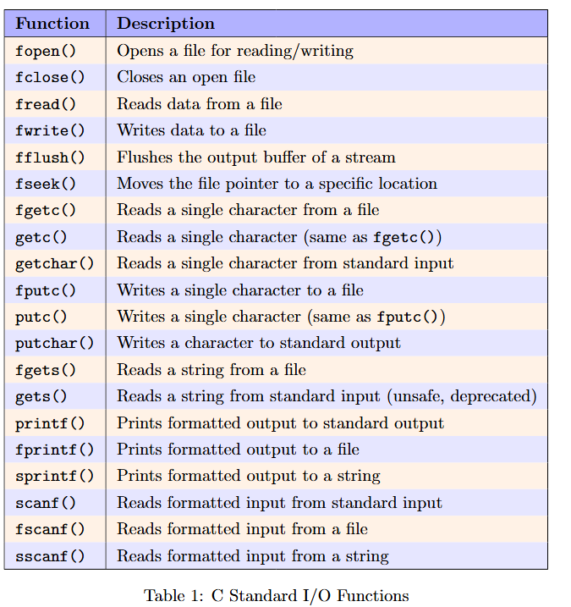
Explanation of stdio Library Functions
Example :sprintf and sscanf

Slide 19
Other stream functions
There are a number of other stdio library functions that use either stream parameters or the standard streams stdin, stdout, stderr:
❑ fgetpos: Get the current position in a file stream.
❑ fsetpos: Set the current position in a file stream.
❑ ftell: Return the current file offset in a stream.
❑ rewind: Reset the file position in a stream.
❑ freopen: Reuse a file stream.
❑ setvbuf: Set the buffering scheme for a stream.
❑ remove: Equivalent to unlink unless the path parameter is a directory, in which case it’s equivalent to rmdir.
These are all library functions documented in section 3 of the manual pages.
Notes:
#include <stdio.h>
int main() {
// Redirect stdout to a file
freopen("output.txt", "w", stdout);
printf("This will be written to output.txt\n");
// Restore stdout back to normal (console)
freopen("/dev/tty", "w", stdout);
printf("This is displayed on the screen\n");
return 0;
}
#include <stdio.h>
int main() {
FILE *fp = fopen("buffered.txt", "w");
// Set buffer mode (line buffering)
char buffer[1024];
setvbuf(fp, buffer, _IOLBF, sizeof(buffer));
fprintf(fp, "Hello, ");
fprintf(fp, "World!\n"); // Data is written only after newline or buffer is full
fclose(fp);
return 0;
}
#include <stdio.h>
int main() {
if (remove("example.txt") == 0) {
printf("File deleted successfully.\n");
} else {
perror("Error deleting file");
}
return 0;
}

Slide 20
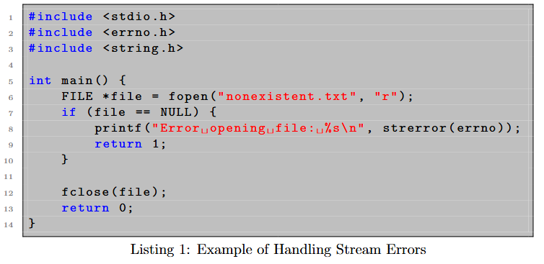
Example stream errors
Notes:
perror automatically prints to stderr, whereas errno + strerror(errno) requires explicit formatting.
perror is simpler when you only need to print the error
message.strerror(errno) allows more flexibility if you need to store, manipulate, or log the error message.

Slide 21
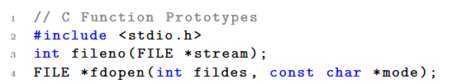
Streams and File Descriptors
Each file stream is associated with a low-level file descriptor.
You can mix low-level input and output operations with higher-level stream operations, but this is generally unwise, because the effects of buffering can be difficult to predict.
You can determine which low-level file descriptor is being used for a file stream by calling the fileno function. It returns the file descriptor for a given stream, or –1 on failure. This function can be useful if you need low-level access to an open stream, for example, to call fstat on it
Example

Slide 22
File and Directory Maintenance
The standard libraries and system calls provide complete control over the creation and maintenance of files and directories.
chmod
chown
unlink,link, symlink
mkdir and rmdir
chdir and getcwd

Slide 23
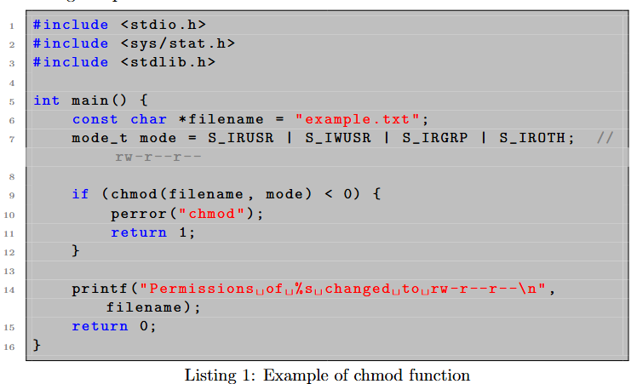
Example chmod()

Slide 24
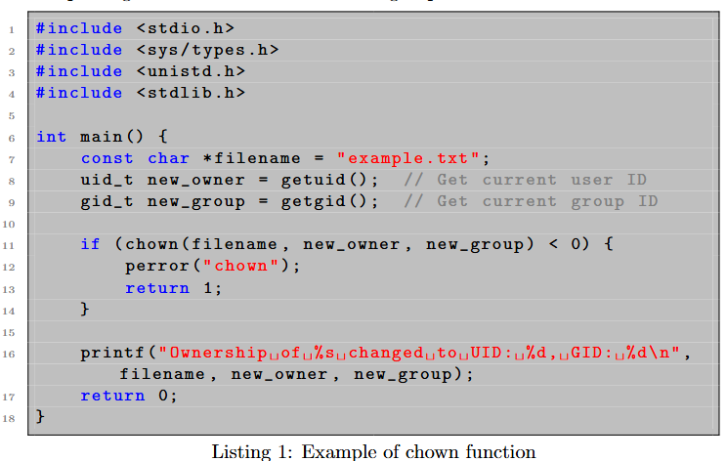
Example chown()

Slide 25
Thank You
Questions?

